Slide 1
Chapter 8 Core Java APIs:
String and StringBuilder

Slide 2
Objectives
In this Chapter, you will learn：
How to create and manipulate Strings
Test equality between Strings and other objects using == and equals().
How to manipulate data using the StringBuilder class and its methods

Slide 3
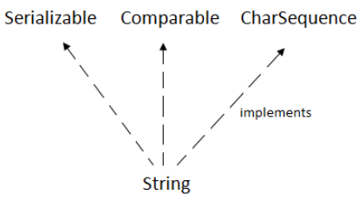
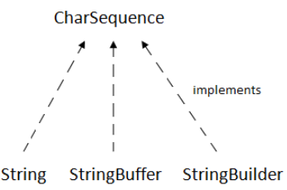
Creating and Manipulating Strings
The String class is a fundamental class that you’d be hard-pressed to write code without it.
You can’t even write a main() method without using the String class
The class String defined in the Java API in the java.lang package.
The String class is perhaps the most-used class in the Java API
Java String class provides a lot of methods to perform operations on strings such as compare(), concat(), equals(), split(), length(), replace(), compareTo(), intern(), substring() etc.
The java.lang.String class implements Serializable, Comparable and CharSequence interfaces.

Slide 4
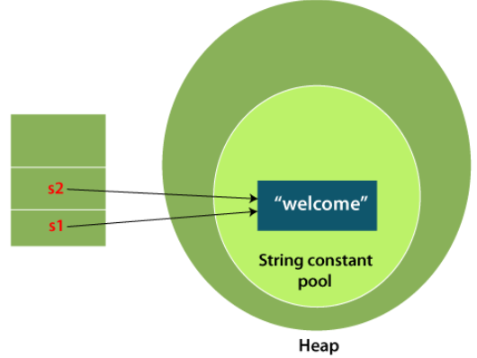


Creating and Manipulating Strings
What is String in Java?
String is a sequence of characters. But in Java, string is an object that represents a sequence of characters.
How to create a string object?
There are two ways to create String object:
By string literal
By new keyword
1) String Literal
Java String literal is created by using double quotes.
For Example:
Each time you create a string literal, the JVM checks the "string constant pool" first. If the string already exists in the pool, a reference to the pooled instance is returned. If the string doesn't exist in the pool, a new string instance is created and placed in the pool. For example:
Note: String objects are stored in a special memory area known as the "string constant pool".

Slide 5
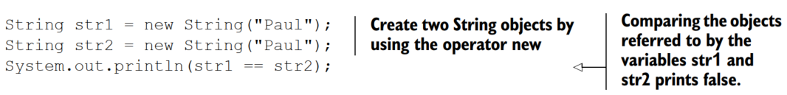
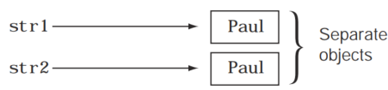
Creating and Manipulating Strings
2. Creating String objects by keyword
String objects created using the operator new always refer to separate objects, even if they store the same sequence of characters.
The operator == compares the addresses of the objects referred to by the variables str1 and str2
In this example, JVM will create a new string object in normal (non-pool) heap memory, and the literal "Welcome" will be placed in the string constant pool. The variable s will refer to the object in a heap (non-pool).

Slide 6
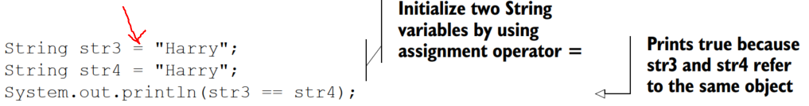
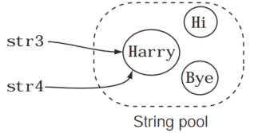
Creating and Manipulating Strings
Note: String objects created using the assignment operator (=) may refer to the same object if they store the same sequence of characters.

Slide 7
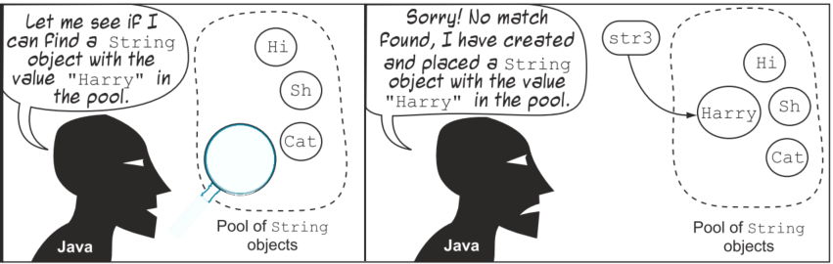
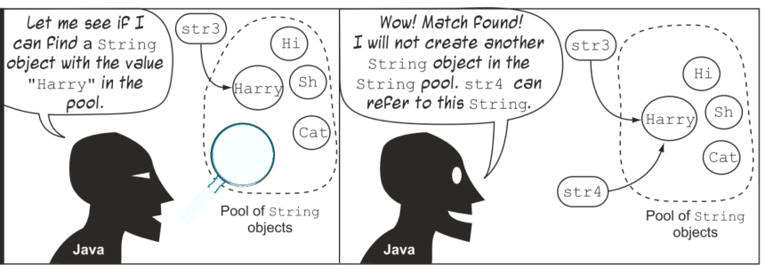
Creating and Manipulating Strings
String str3 = "Harry";
String str4 = "Harry";
Java doesn’t create a new String object in this case, and the variable str4 refers to the existing String object "Harry"

Slide 8
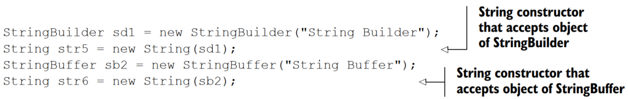
Creating and Manipulating Strings
These values are reused from the String constant pool if a matching value is found. If a matching value isn’t found, the JVM creates a String object with the specified value and places it in the String constant pool:
Create objects of String using the classes StringBuilder and StringBuffer:
The default value for String is null.
Why String class is Final in Java?

Slide 9
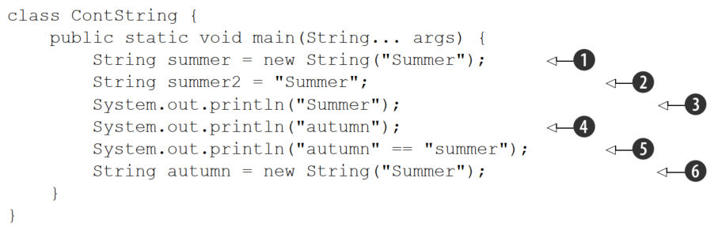
Creating and Manipulating Strings
Create a new String object with the value "Summer". This object is not placed in the String constant pool.
Creates a new String object with the value "Summer" and places it in the String constant pool
Doesn’t need to create any new String object. It reuses the String object with the value "Summer" that already existed in the String constant pool.
Create a new String object with the value "autumn" and place it in the String constant pool.
Reuse the String value "autumn" from the String constant pool. It creates a String object with the value "summer" in the String constant pool (note the difference in the case of letters—Java is case-sensitive and "Summer" is not the same as "summer").
Create a new String object with the value "Summer".

Slide 10
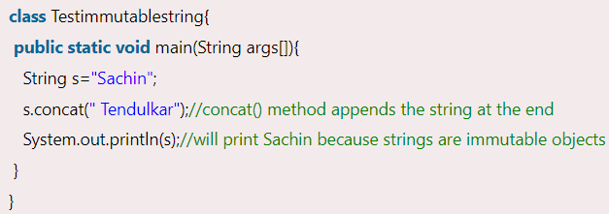
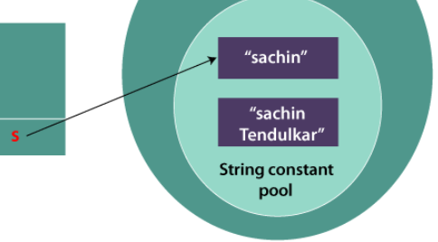
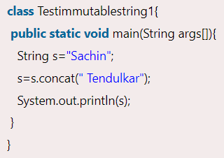
The class String is immutable
The class String is immutable: once created, the contents of an object of the class String can never be modified.
The immutability of String objects helps the JVM reuse String objects, reducing memory overhead and increasing performance.
The string class is final so that no one can override the methods of the String class.
So that it can provide the same features to the new String objects as well as to the old ones.
Sachin Tendulkar

Slide 11
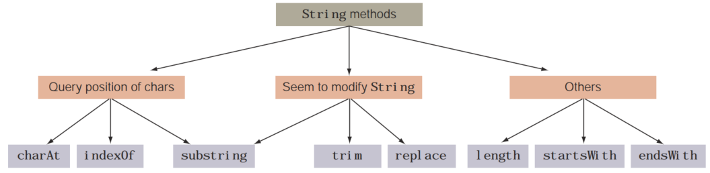

Methods of the class String
CHARAT() Method
You can use the method charAt(int index) to retrieve a character at a specified index of a String:
System.out.println(name.charAt(4)); will throw an exception at runtime

Slide 12
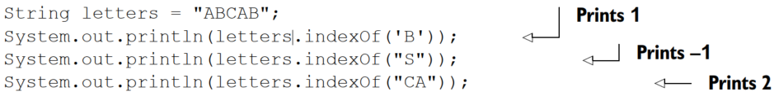
Methods of the class String
INDEXOF() Method
You can search a String for the occurrence of a char or a String. If the specified char or String is found in the target String, this method returns the first matching position; otherwise, it returns -1:
By default, the indexOf() method starts its search from the first char of the target String.
you can set the starting position, as:

Slide 13


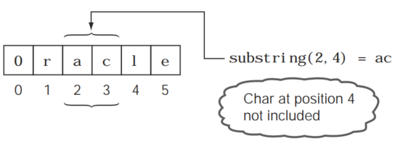
Methods of the class String
SUBSTRING() Method
The substring() method is shipped in two flavors. The first returns a substring of a String from the position you specify to the end of the String:
You can also specify the end position with this method as:
NOTE: Length of String returned by substring() = end - start

Slide 14
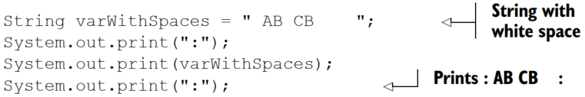

Methods of the class String
Trim() method
The trim() method returns a new String by removing all the leading and trailing white space in a String. White spaces are blanks (new lines, spaces, or tabs).
Note: Trim method does not remove the space within a String.

Slide 15

Methods of the class String
Replace() method
This method will return a new String by replacing all the occurrences of a char with another char. Instead of specifying a char to be replaced by another char, you can also specify a sequence of characters—a String to be replaced by another String:
NOTE: the type of the method parameters passed on this method: either char or String. You can’t mix these parameter types, as the following code shows:
Length() method
You can use the length() method to retrieve the length of a String.

Slide 16
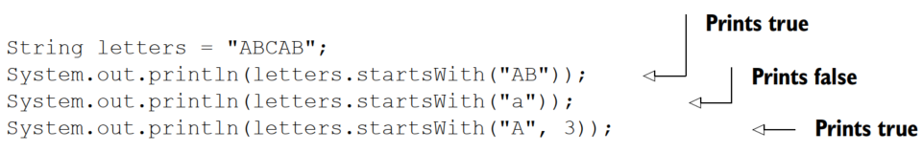
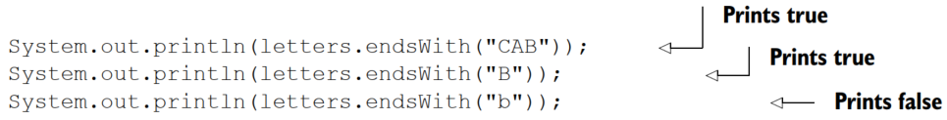
Methods of the class String
StartsWith() and EndsWith() methods
The method startsWith()determines whether a String starts with a specified prefix, specified as a String. You can also specify whether you wish to search from the start of a String or from a particular position. This method returns true if a match is found and false otherwise:
The method endsWith() tests whether a String ends with a particular suffix. It returns true for a matching value and false otherwise:

Slide 17
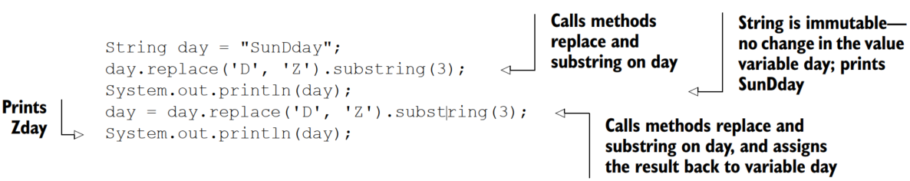
Methods of the class String
METHOD CHAINING: use multiple String methods in a single line of code
The methods are evaluated from left to right.

Slide 18
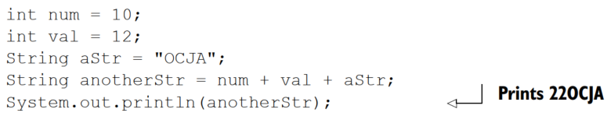
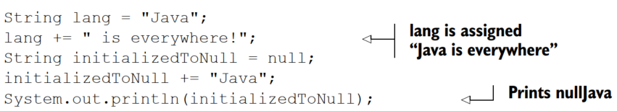
String objects and operators
Concatenation operators (+ and +=) have a special meaning for Strings.
The Java language has additional functionality defined for these operators for String.
You can use the operators + and += to concatenate two String values.
String concatenation is implemented by using the StringBuilder.

Slide 19
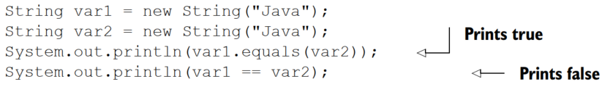
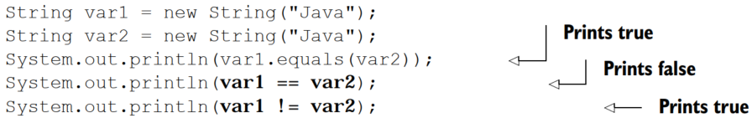
String objects and operators
Determining equality of Strings
Use the equals method to compare two Strings.
This method returns a true value if the object being compared to it isn’t null, is a String object, and represents the same sequence of characters as the object to which it’s being compared.
The operator == compares the reference variables, that is, whether the variables refer to the same object

Slide 20
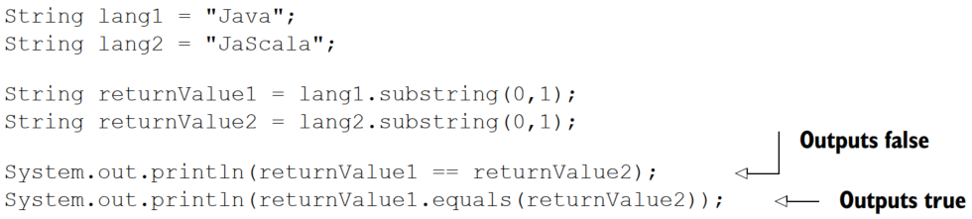
String objects and operators
EQUALITY OF VALUES RETURNED BY STRING METHODS
These substring values aren’t stored in the String pool because these substrings are created using the new operator in String’s method substring (and other String methods).

Slide 21
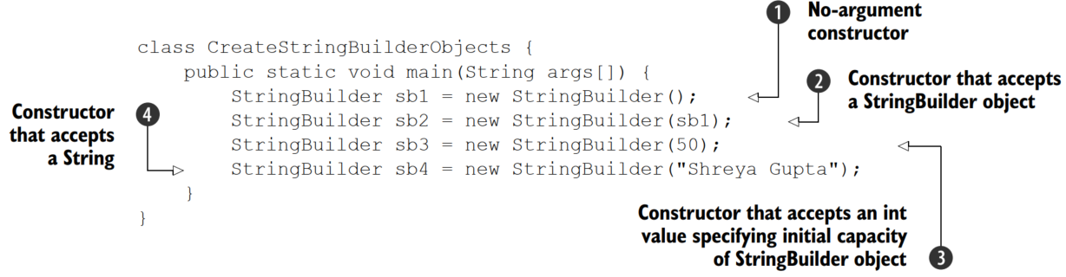
Mutable strings: StringBuilder
The class StringBuilder is defined in the package java.lang, and it has a mutable sequence of characters.
1) Construct a StringBuilder object with no characters in it and an initial capacity of 16 characters.
2) Constructs a StringBuilder object that contains the same set of characters as contained by the StringBuilder object passed to it.
3) Construct a StringBuilder object with no characters and an initial capacity of 50 characters.
4) Construct a StringBuilder object with an initial value as contained by the String object.

Slide 22
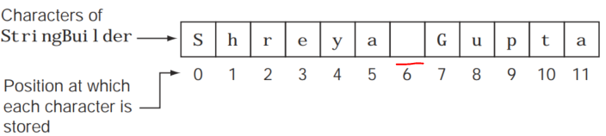
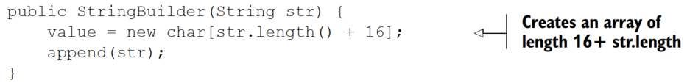
Mutable strings: StringBuilder
The class StringBuilder is defined in the package java.lang, and it has a mutable sequence of characters.
Create StringBuilder object using its default constructor

Slide 23
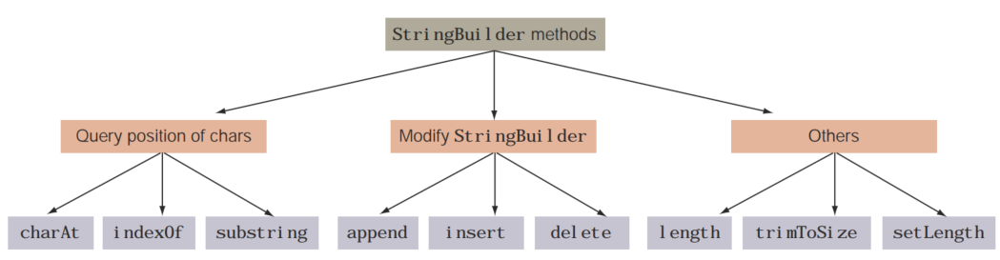
Methods of class StringBuilder
Append() method
The append method adds the specified value at the end of the existing value of a
StringBuilder object.
Because you may want to add data from multiple data types to a StringBuilder object, this method has been overloaded so that it can accept data of
any type.

Slide 24
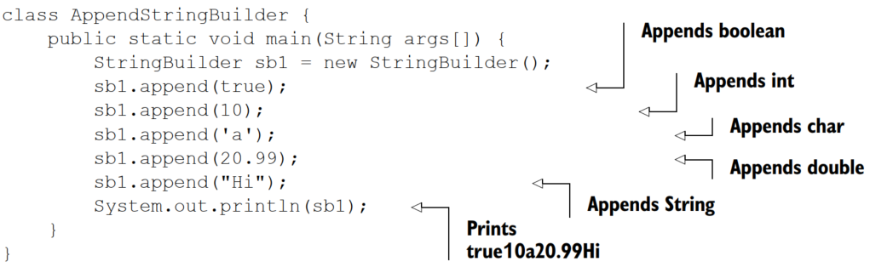
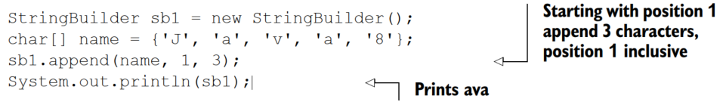
Methods of class StringBuilder
Append() method
The append method adds the specified value at the end of the existing value of a
StringBuilder object.
Because you may want to add data from multiple data types to a StringBuilder object, this method has been overloaded so that it can accept data of
any type.
Accepts all the primitives String, char array, and Object, as method parameters

Slide 25
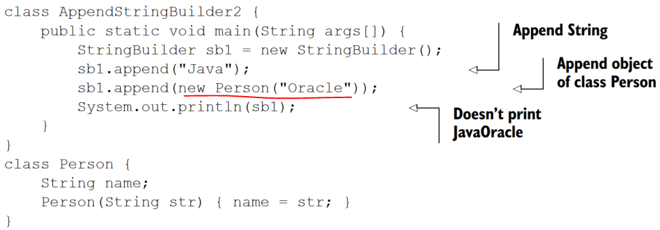
Methods of class StringBuilder
you can pass to the append method any object from the Java API or your own user-defined object:
Output is: JavaPerson@126b249
The hex value (126b249) that follows the @ sign may differ on your system.
Note: the default implementation of the method toString in the class Object returns the name of the class followed by the @ char and unsigned hexadecimal representation of the hash code of the object.

Slide 26
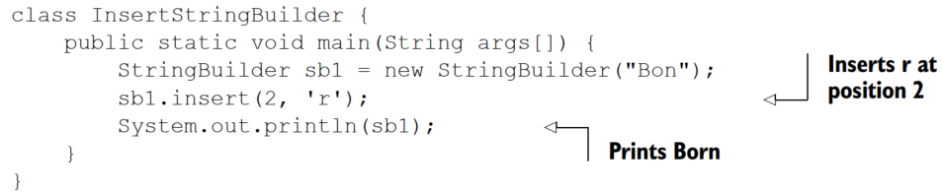
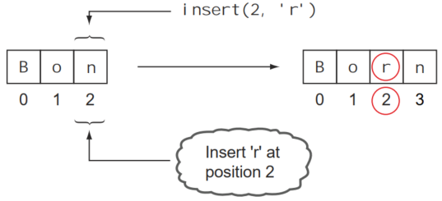
Methods of class StringBuilder
INSERT() method
The insert method is as powerful as the append method.
The main difference between the append and insert methods is that the insert method enables you to insert the requested data at a particular position, but the append method allows you to add the requested data only at the end of the StringBuilder object:

Slide 27
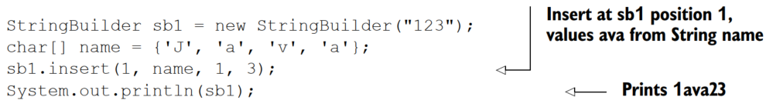
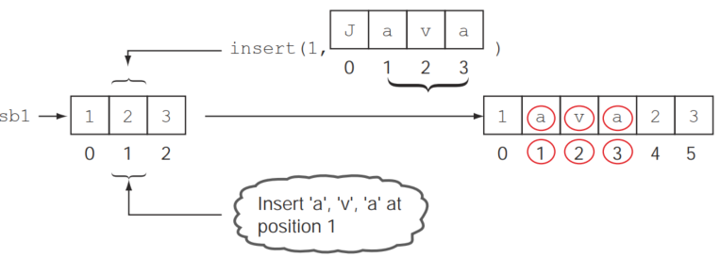
Methods of class StringBuilder
INSERT() method

Slide 28
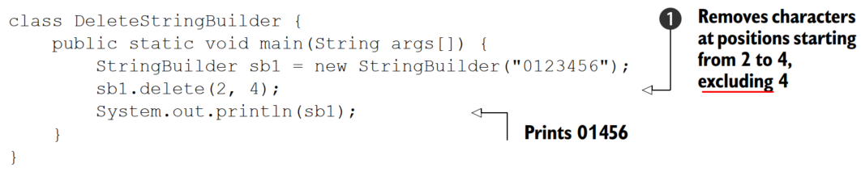
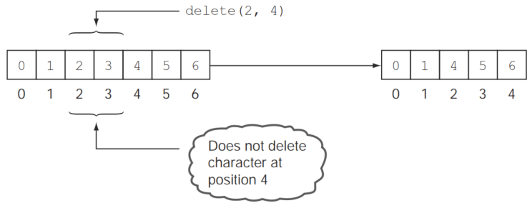
Methods of class StringBuilder
Delete() AND DeleteCharAt()
The method delete removes the characters in a substring of the specified StringBuilder. The method deleteCharAt removes the char at the specified position.
Here’s an example showing the method delete:

Slide 29
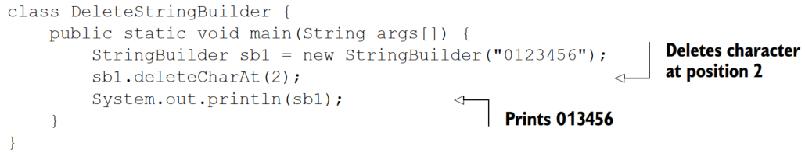
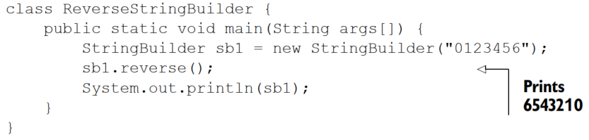
Methods of class StringBuilder
Delete() AND DeleteCharAt()
NOTE: Unlike the class String, the class StringBuilder doesn’t define the method trim.
Reverse() method:
The reverse method reverses the sequence of characters of a StringBuilder:
Note: You can’t use the method reverse to reverse a substring of StringBuilder.

Slide 30
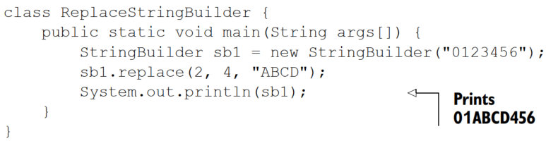
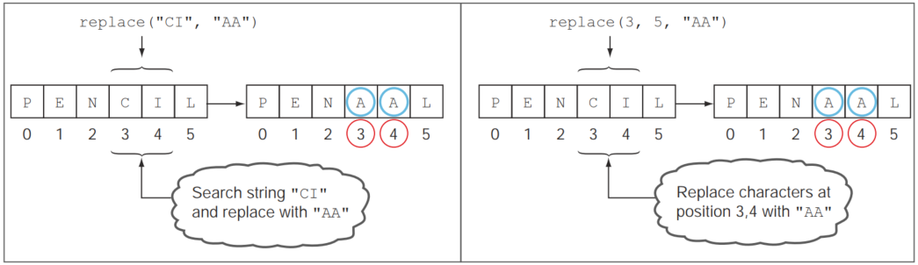
Methods of class StringBuilder
REPLACE() method
The replace method in the class StringBuilder replaces a sequence of characters, identified by their positions, with another String, as:
Method in String
Method StringBuilder

Slide 31
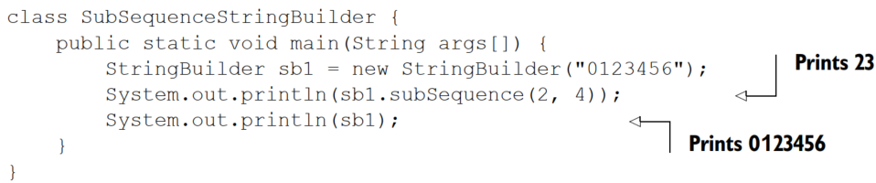
Methods of class StringBuilder
SUBSEQUENCE() method
The replace method in the class StringBuilder replaces a sequence of characters, identified by their positions, with another String, as:
The method subSequence to retrieve a subsequence of a StringBuilder object.
NOTE: The method subsequence doesn’t modify the existing value of a StringBuilder object.

Slide 32
Summary
The class String:
■ The class String represents an immutable sequence of characters.
■ A String variable can be initialized by using the operator new or by using the assignment operator with String literal values.
■ String objects created using a String literal without the new operator are placed in a pool of String objects. Whenever the JRE receives a new request to initialize a String variable using the assignment operator, it checks whether a String object with the same value already exists in the pool. If one is found, it returns the object reference for the existing String object from the pool.
■ String objects created using the operator new are never placed in the pool of String objects.
■ The comparison operator (==) compares String references, whereas the equals method compares the String values.
■ None of the methods defined in the class String can modify its value.
■ The Java language provides special support for concatenating String objects by using the operators + and +=.
■ The right technique for comparing two String values for equality is to use the method equals defined in the String class. This method returns a true value if the object being compared isn’t null and is a String object that represents the same sequence of characters as the object to which it’s being compared.
■ The comparison operator == determines whether both of the reference variables are referring to the same String objects. Hence, it’s not the right operator for comparing String values

Slide 33
Summary
The class StringBuilder:
■ The class StringBuilder is defined in the package java.lang and represents a mutable sequence of characters.
■ The StringBuilder class is very efficient when a user needs to modify a sequence of characters often. Because it’s mutable, the value of a StringBuilder object can be modified without the need to create a new StringBuilder object.
■ A StringBuilder object can be created using its constructors, which can accept either a String object, another StringBuilder object, an int value to specify the capacity of StringBuilder, or nothing.
■ The methods charAt, indexOf, substring, and length defined in the class StringBuilder work in the same way as methods with the same names defined in the class String.

Slide 34
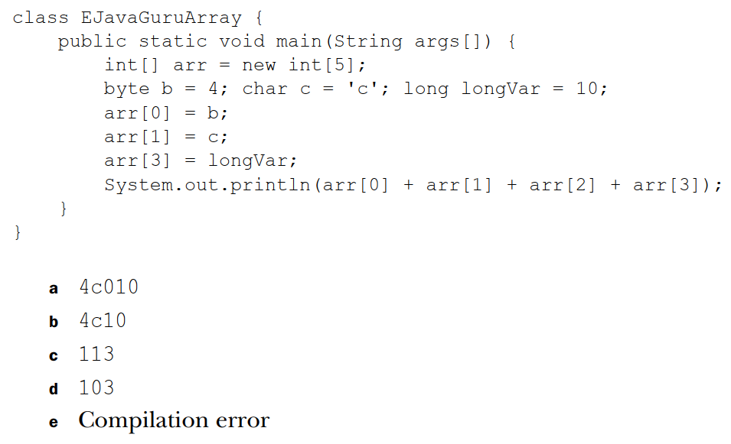
Questions
1. What is the output of the following code?

Slide 35
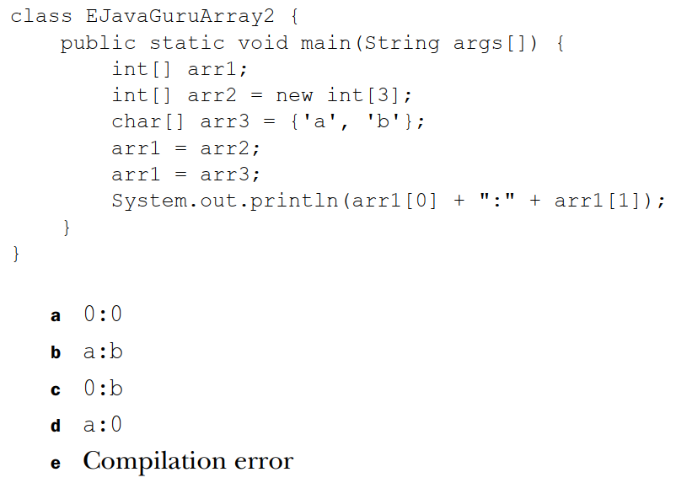
Questions
1. What is the output of the following code?

